Slide 1

Python and Excel Playing Together
Douglas Davidi

Slide 2
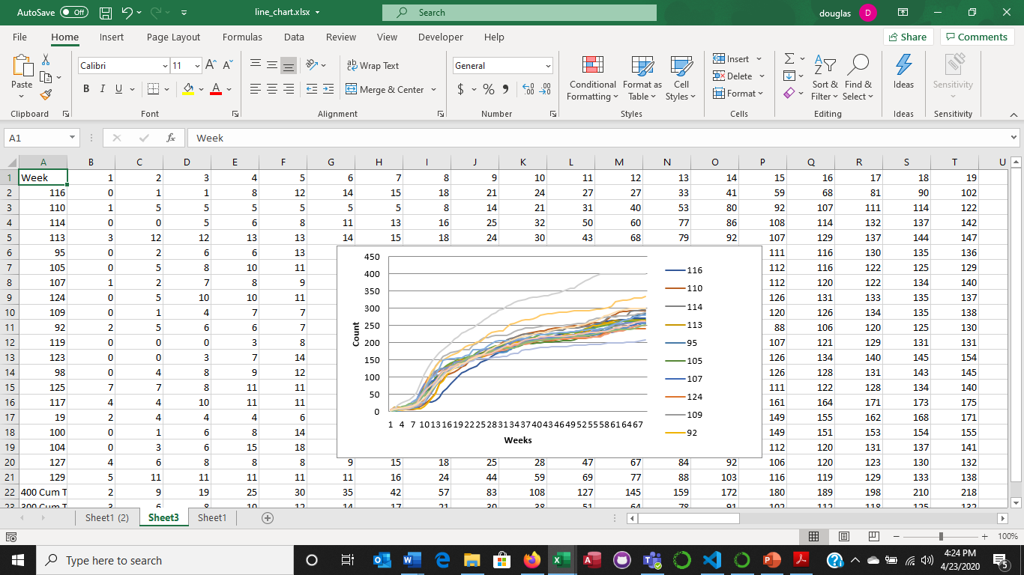
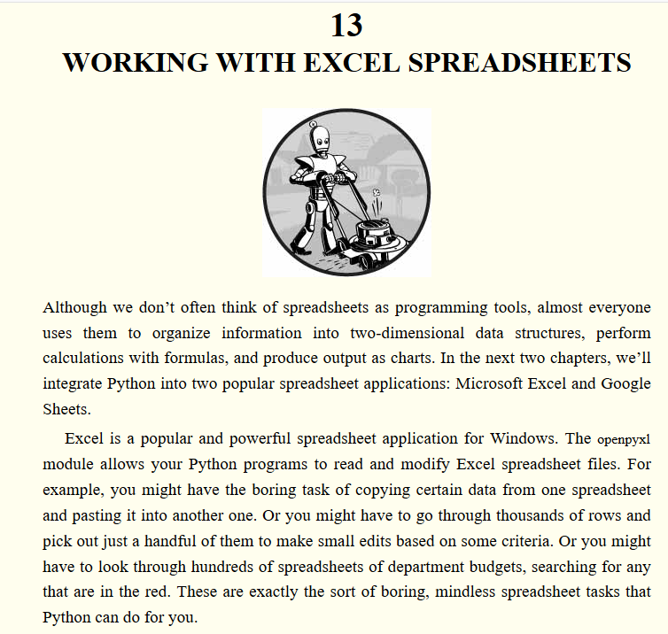

Excel & Python Playing Together “Automate the Boring Stuff” Coder: Douglas Davidi
Automate the process of converting raw data downloads from business systems into usable information and create line or bar charts to communicate.
Credits:
Automate the boring stuff: https://automatetheboringstuff.com/2e/chapter13/
Real Python.com “A Guide to Excel Spreadsheets in Python With openpyxl” https://realpython.com/openpyxl-excel-spreadsheets-python/#before-you-begin

Slide 3
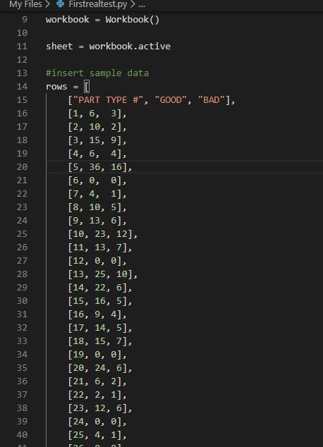
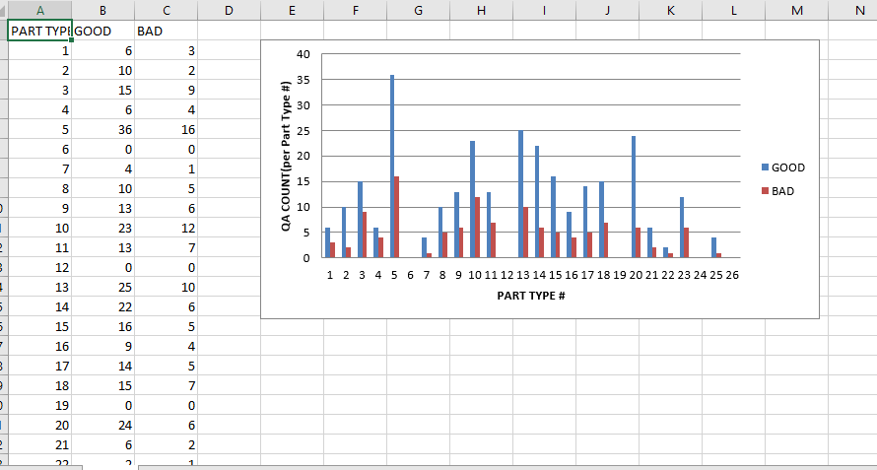
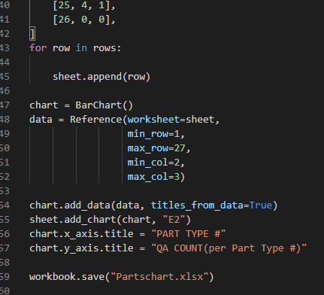
The First Chart
The code sample to created a file and its data from scratch within Python. Named column labels then populated data within the cells of each column
Realpython code contained:
Formatting spreadsheet(s) while creating
Filters , freeze rows, colors, conditional formatting, adding sheets, renaming sheets
Finished with charts
Problem Statement: How do I use existing raw data (CSV/Excel) acquired from business systems to build charts and analyze?

Slide 4
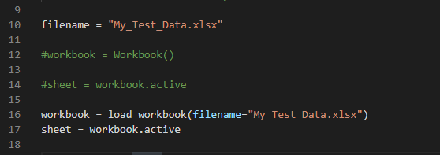
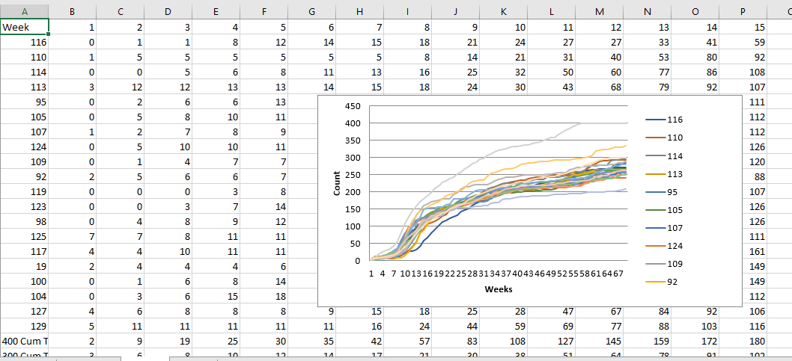
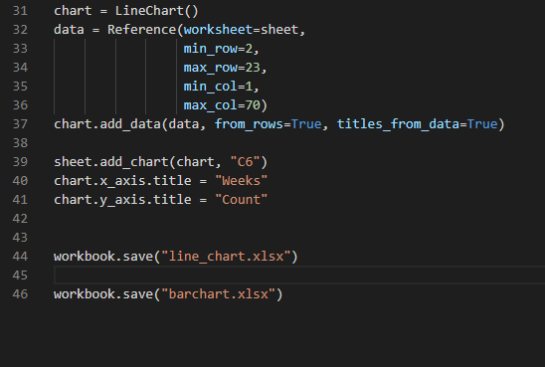
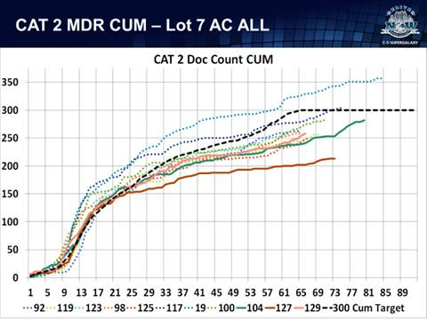
Actual Data
Actual data from IS used to document Material Defects during aircraft modification.
Actual example shown to compare
Building the chart from a data dump was a primary process I wanted to model. Will continue with the development to format chart and insert into a power point.
The class has shown me the potential application of Python across the Business Information Systems that are incapable of producing reports or interfacing with other systems in the business.
New IS are expensive and Python can bridge the gap between systems

Slide 5

Lessons Learned
Proper forking of Repositories!!
Need to use git hub for version control (not creating a new file each time)
Improve search Git Hub and other open sources for code that will help me attain results
Need stronger understanding of Python (objects, variables, functions, class, etc.)
Being able to conceptually understand what the code is doing to make it work
Python is powerful and a useful skill to acquire regardless
Can be used to create intermediary processes between systems in order to analyze data, create reports and communicate information
Douglas Davidi

